Slide 1
Speech Emotion Recognition (SER)
Kyle Calabro
Dr. Scott Frees, Advisor
Dr. Osei Tweneboah, Reader
Dr. John Kerrigan, Reader (Rutgers University)

Slide 2
Introduction to SER

Slide 3
SER and Challenges Within the Domain
Speech Emotion Recognition (SER)
Task of recognizing the emotional aspects of speech irrespective of the semantic contents
Challenges:
Lack of quality training data
Data collection is complex and expensive
Most speech corpora are imbalanced
Noiseless environments used for recording in simulated data sets
Performance dependent on types of emotional expressions used in given speech corpus
Overall low classification performance
58 - 80% accuracy depending on speech corpus and method

Slide 4
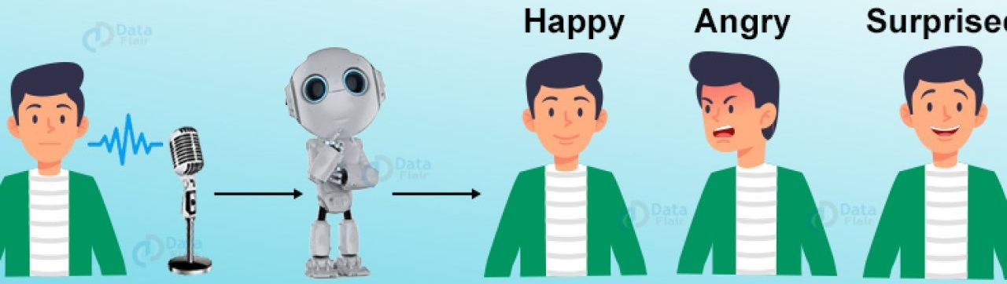
Applications of SER
Speech Language Pathology (SLP) Therapy
Artificial Intelligence Systems
Robots
Call Centers
Improve customer satisfaction
Many others...

Slide 5
Approaches to SER
Classical
Extract features from raw audio:
Energy
Pitch
Mel-frequency cepstral coefficients
Filter banks
Chroma
Utilize more traditional machine learning algorithms to perform classification task
Support Vector Machines
Recurrent Neural Networks
Multilayer Perceptrons
Conventional
Convert audio samples to spectrogram images
Visual method of representing the signal strength over time at various frequencies present in a particular sound wave
Utilize convolutional neural networks (CNNs) to classify spectrogram images

Slide 6
Recording Audio and Audio Preprocessing

Slide 7
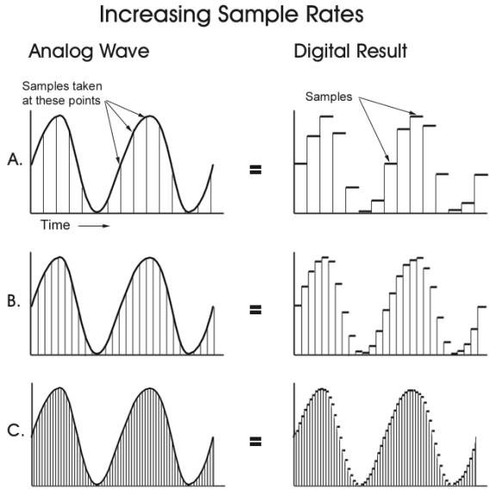
Sampling Rate and Bit Depth
Sound waves are analog, continuous time-signals
Must be converted to digital, discrete-time signals to record and store sound
Sampling Rate - Number of audio samples taken per second
Increasing rate allows for a better approximation of the actual analog sound signal, increases the amount of data being recorded
Bit Depth - Number of possible amplitude values for a single sample of a discrete-time audio signal
Higher bit depth yields higher resolution of the discrete-time audio signal
Effect of Increasing Sampling Rate

Slide 8
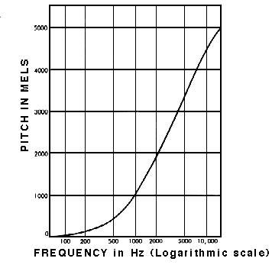
Generating Log-mel Spectrograms
Frame the given signal into small overlapping audio frames
Calculate periodogram estimates of the power spectrum for each audio frame
Fast Fourier Transform
Map spectrum’s powers onto the mel-scale using a mel-filterbank yielding filterbank energies
Apply logarithmic function to filterbank energies
Applied as humans do not hear loudness on a linear scale
Compresses features so they match more closely what humans actually hear
Perform discrete cosine transform (DCT) on log mel-filterbank energies
Yields the mel-frequency cepstral coefficients (MFCCs)
Generate spectrogram with MFCCs and Short Time Fourier Transform (STFT)
Add results of STFT to matrix which records the magnitude and phase for each point in time and frequency
Mel-scale as a Function of Frequency

Slide 9
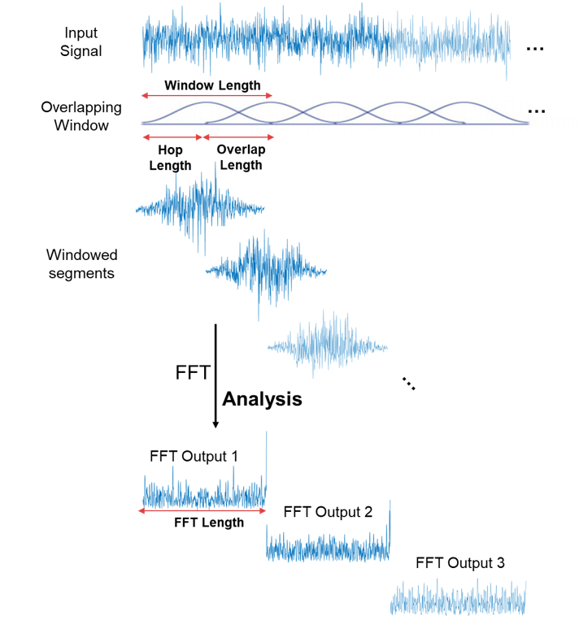
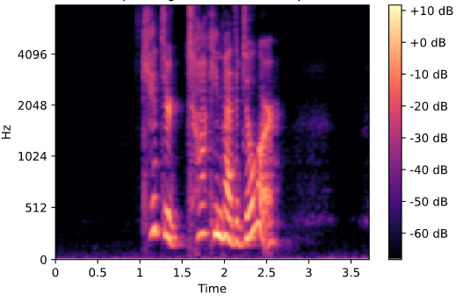
Generating Log-mel Spectrograms (contd.)
Typical Log-mel Spectrogram
Short Time Fourier Transform

Slide 10
Speech Corpora

Slide 11
RAVDESS
Ryerson Audio-Visual Database of Emotional Speech and Song
Designed and created specifically for use in SER
Released in 2018 by the SMART lab at the Ryerson University (Toronto, Ontario, Canada)
Simulated, multimodal data set (audio and video)
24 actors (12 male, 12 female) [21 - 33 years old]
Each recorded two lexically matched sentences in eight different emotions at two intensities
“Kids talking by the door”
“Dogs are sitting by the door”
Emotions:
Neutral, calm, happy, sad, anger, fear, disgust, and surprise
Sampling rate - 48 kHz
Bit depth - 16 bits per sample
1,440 recording samples total
96 from the neutral class, 192 each for the remaining seven emotional classes

Slide 12
CREMA-D
Crowd-sourced Emotional Multimodal Actors Dataset
Released in 2014
Collaborative project amongst Ursinus College, the University of Pennsylvania, and the University of Illinois Chicago
91 actors (48 male, 43 female) [20 - 74 years old]
Recorded 12 emotionally neutral sentences at 4 intensities each with six emotions
“Don’t forget a jacket”
“I think I’ve seen this before”
Emotions:
Anger, disgust, fear, happy, neutral, and sad
Sampling rate - 16 kHz
Bit depth - 16 bits per sample
7,442 recording samples total
1,087 for neutral class, 1,271 each for remaining five emotional classes

Slide 13
Related Works

Slide 14
Works with RAVDESS Speech Corpus
“Head fusion: Improving the accuracy and robustness of speech emotion recognition on the IEMOCAP and Ravdess Dataset” [1]
Attention-based CNN
‘‘Speech Emotion Recognition With deep convolutional neural networks” [2]
One-dimensional CNN
Chromagram, mel-scale spectrogram values, tonnetz representation, and spectral contrast features
“Learning fine-grained multimodal alignment for speech emotion recognition’’ [3]
Multimodal approach capturing intercorrelations between modalities
“A CNN-assisted enhanced audio signal processing for speech emotion recognition” [4]
AI-assisted deep stride CNN
“Spectrogram based multi-task audio classification” [5]
Gated residual network deployed on spectrograms

Slide 15
Works with CREMA-D Speech Corpus
“Multimodal and temporal perception of audio-visual cues for emotion recognition” [6]
Embeds video clips using their audio-visual content onto a metric space where their gap is reduced and their complementary and supplementary information is explored
Temporal deep network framework
“Metric learning based multimodal audio-visual emotion recognition” [7]
Unimodal and multimodal approaches
RBF-SVM with metric learning
Fear, disgust, and surprise emotional classes benefit from multimodal approach

Slide 16
Convolutional Neural Networks (CNN)

Slide 17
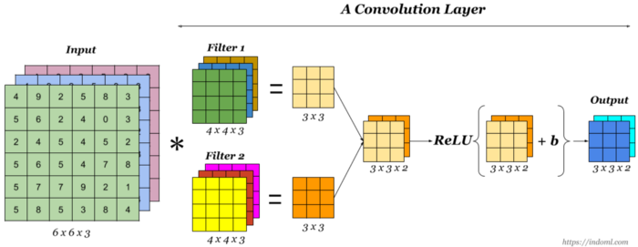
Components of a CNN
Convolutional Layers
Fundamental building blocks of a CNN
Neuron’s weights can be represented as a small image the size of the receptive field, referred to as a filter or kernel
Layer full of neurons using the same filter outputs a feature map
Highlights the areas in an image that activate the given filter the most
Convolutional layers learn the most useful filters for its task, and the layers above will learn to combine the filters into progressively more complex patterns
Activation function used to increase non-linearity in the output
ReLU typically used

Slide 18
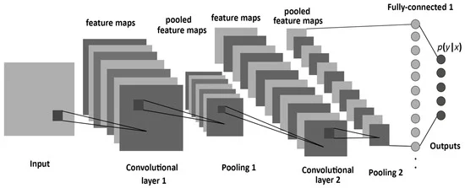
Components of a CNN (contd.)
Pooling Layers
Subsample/shrink the input image to reduce computational load, memory usage, and number of parameters (weights of the connections)
Aid in mitigating overfitting
Max pooling
Average pooling
Global average pooling
Fully-connected Layers
Fully-connected neural network
Last layer outputs estimated class probabilities
Softmax activation function
Multiclass classification
Typical Architecture of a CNN

Slide 19
Proposed Methodology
Raw Audio Data Augmentation
Image Enhancement
Transfer Learning
Ensemble Learning

Slide 20
Raw Audio Data Augmentation
Purpose
Increase amount of training data available
Improve generalizability of model(s) to real-world
Techniques
Adding Gaussian noise
Stretching of audio - factor of 0.8 and 1.2 applied
Time shifting of audio
Shifting pitch of audio
Increase by a major third
Increase by a quarter tone
Decrease by a tritone

Slide 21
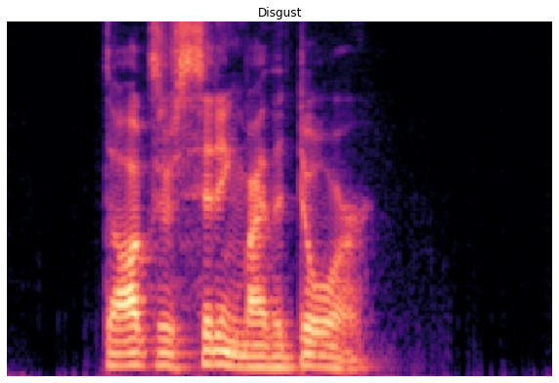
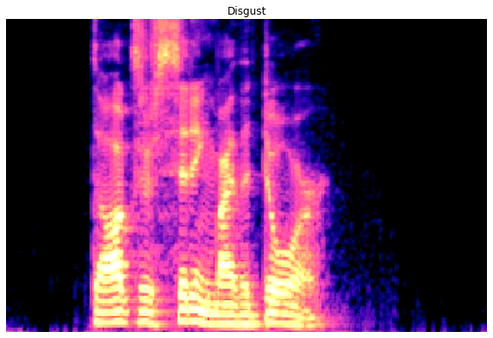
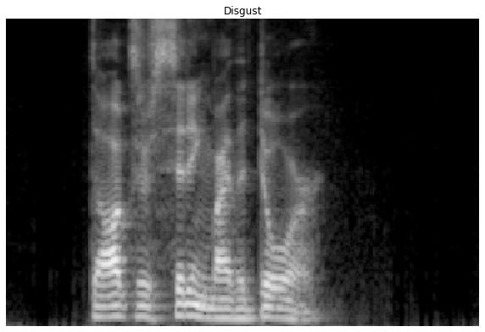
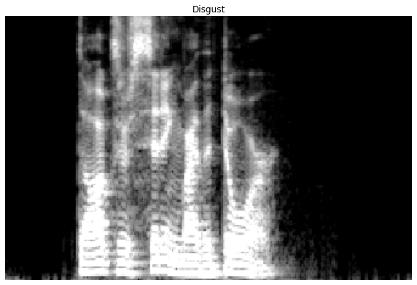
Image Enhancement
Purpose
Construct invariant features that may be recognized as prominent features by a CNN during training
Techniques
Contrast-stretching
Expands a narrow range of input levels into a wide, stretched, range of output levels, resulting in an image of higher contrast
CNNs shown to be sensitive to changes in contrast and brightness
Grayscale conversion
Grayscale conversion and contrast-stretching
Original
Contrast-stretching
Grayscale Conversion
Grayscale Conversion and Contrast-stretching

Slide 22
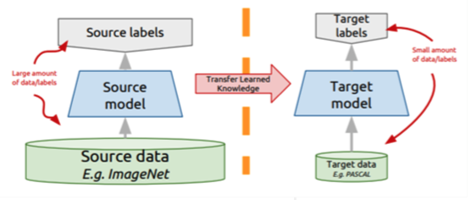
Transfer Learning
Purpose
Neural network trained on different source domain, for a different source task may be adapted for a new domain and target task
Relaxes hypothesis that training data must be independent and identically distributed with the test data
Suitable option for domains suffering from insufficient training data
Model(s) in target domain need not be trained from scratch
Tools Used
Convolutional neural networks pre-trained on ImageNet dataset
Contains 1.2 million images from 1,000 classes

Slide 23
Transfer Learning Methods
Feature Extraction (FE)
Maintains existing parameters (weights) of convolutional layers without updating them
Modify fully-connected layers to suit target task
Fine-tuning (FT)
Allow training to occur on some of the convolutional layers of a pre-trained network
Weights of user-defined layers will be updated during training
Must use a low learning rate
Prevent sudden, abrupt adjustments to the trainable weights
Incurs higher risk of overfitting

Slide 24
Ensemble Learning
Combine multiple machine learning algorithms and models to generate predictions
Typically offers marginal performance gains over individual classifiers that the ensemble is composed of
Promotes robustness
Model averaging ensemble
Combines predictions from each individual classifier in the ensemble equally

Slide 25
Review of Methods

Slide 26
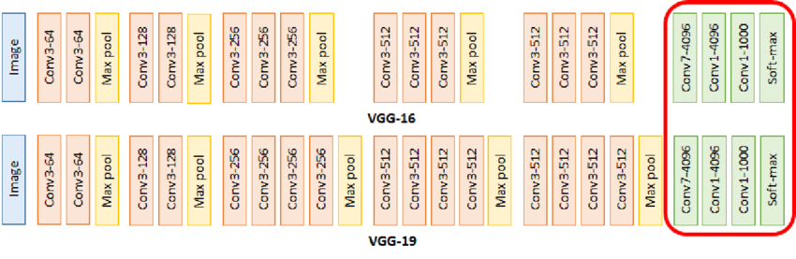
“Novel Models” of Transfer Learning
VGG-16 and VGG-19
Utilize very small convolutional filters (3 x 3)
Spatial resolution is preserved after convolutions
Convolutional stride and padding fixed to one pixel
Max pooling
Architecturally simplistic
VGG-16 and VGG-19 Model Architecture

Slide 27
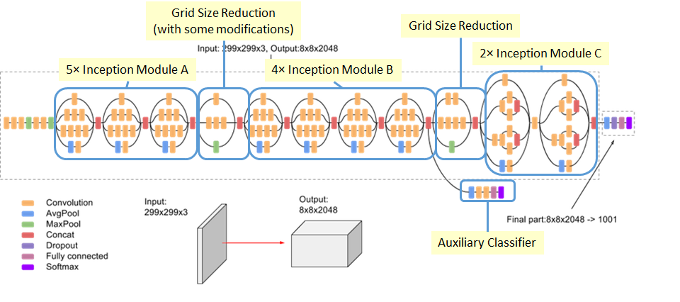
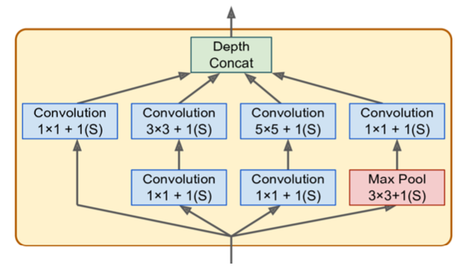
“Novel Models” of Transfer Learning (Contd.)
InceptionV3
Third version of Google’s Inception Convolutional Neural Network (GoogLeNet)
Label smoothing
Factorized convolutions
Reduce number of parameters without decreasing efficiency
Batch normalization
Auxiliary classifier
Exchanges architectural simplicity for a lower number of parameters
Inception modules
Inception Module
InceptionV3 Architecture

Slide 28
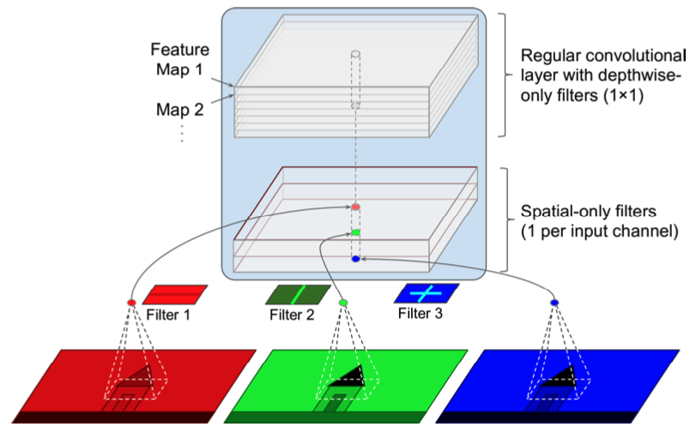
“Novel Models” of Transfer Learning (Contd.)
Xception
“Extreme Inception” - incredibly similar architecture to that of InceptionV3
Replaces inception modules with depthwise separable convolutions
Depthwise convolution - spatial convolution performed independently over each channel of input
Pointwise convolution - project the channel’s output by the depthwise convolution onto a new channel space
Serves to apply a single spatial filter for each input feature map and look exclusively for cross-channel patterns
Depthwise Separable Convolution

Slide 29
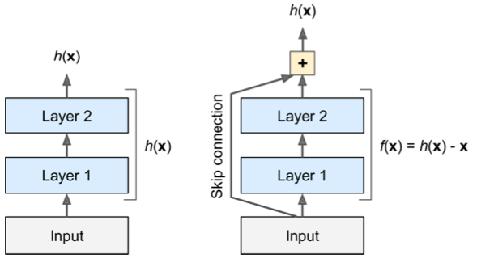
“Novel Models” of Transfer Learning (Contd.)
ResNet-50
Reformulate layers as learning residual functions with reference to the layer inputs, rather than learning unreferenced features (residual learning)
Signal feeding into a layer is also added to the output of a layer located higher up the stack
Skip connections
Reformulated layers are called residual units, the stack creates a residual network
Allows network to make considerable progress even if several layers have not yet begun training
Visualizing Residual Learning

Slide 30
AlexNet
Breakthrough in CNN architectures
First architecture to stack convolutional layers directly on top of each other rather than stacking a pooling layer on top of each convolutional layer
First to utilize the Rectified Linear Unit (ReLU) activation function, rather than the tanh function
Reduced training time by a factor of six on the CIFAR-10 dataset
Local Response Normalization
The most strongly activated neurons inhibit other neurons located at the same position in neighboring feature maps
Encourages different feature maps to specialize, pushing them apart and forcing them to explore a wider range of features, improving generalization
Utilized as a non-pre-trained baseline deep convolutional neural network within this work
Fully-connected layers modified to suit target task

Slide 31
Experimental Procedure

Slide 32
Tools Used
Python
TensorFlow
Librosa
Scikit-learn
Scikit-image
Google Colab Pro Plus
Google Cloud Platform
Google Cloud Storage
Bucket(s) hold various sets of spectrograms
Tensor Processing Units (TPU)
Quantization
Systolic array architecture
Effect on training time
Ex. VGG-16 fine-tuning
GPU - 6 hour 43 minutes
TPU - 1 hour 43 minutes
Distributed cloud system
TensorFlow Data Input Pipeline

Slide 33
Tools Used - TensorFlow Data Input Pipeline
Remote procedure call of TPU has a 2 GB limit
Larger datasets require use of input pipeline
Allows for iterations of the data to be passed in a streaming fashion
Full dataset need not fit in memory or be passed at once
Pipeline uses multiple threads to process elements as they are passed as input to models
Autotune
Sets the number of parallel calls dynamically based on resource availability at runtime
Improves throughput and latency
Prefetch
Allows elements to be prepared while the current element is being processed, in parallel via Autotune
Background thread and internal buffer

Slide 34
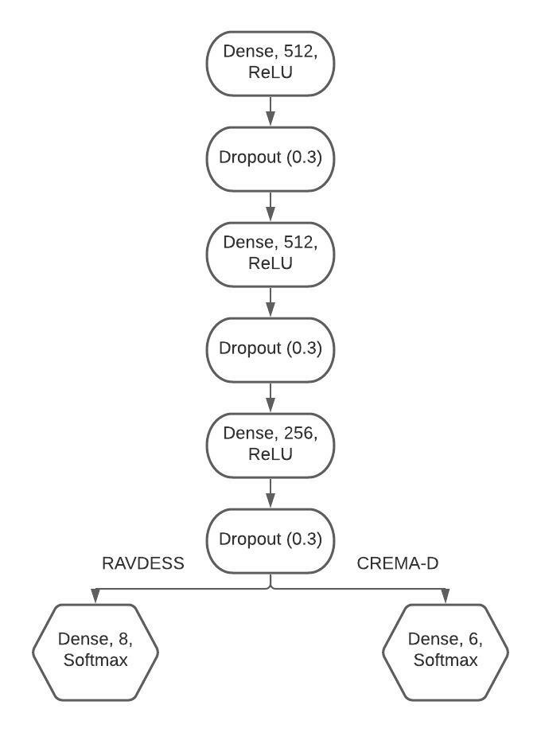
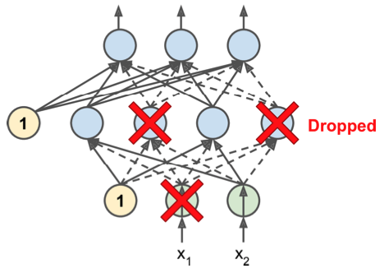
Regularization and Fully-connected Layers
Regularization - Dropout
At every training step, every neuron, including the input neurons, but excluding the output neurons, is given a probability p of being temporarily “dropped out”
Being dropped out means that the given neuron will be entirely ignored during this training step, but may be active during the next step
Neurons trained with dropout cannot co-adapt with their neighboring neurons
Neurons must be as useful as possible on their own
Results in neurons that are less sensitive to slight changes in the inputs, yielding a more robust network that generalizes better
Visualizing Dropout
Fully-connected Layers Architecture

Slide 35
Model Training and Tuning Hyperparameters
All models trained for 30 epochs
Learning Rate
Transfer learning models - 0.00001
AlexNet models - annealing learning rate
Initialized to 0 .001
Minimum of 0.00001
Patience of 3 epochs, monitoring test accuracy
Optimizers
Transfer learning models - RMSProp
AlexNet models - Adam
Fine-tuning
VGG-16/VGG-19
Last two convolutional blocks set to trainable
InceptionV3
Last convolutional block trainable, remainder frozen
Xception
First two convolutional blocks frozen, remainder are trainable
ResNet-50
Last convolutional block trainable, remainder frozen

Slide 36
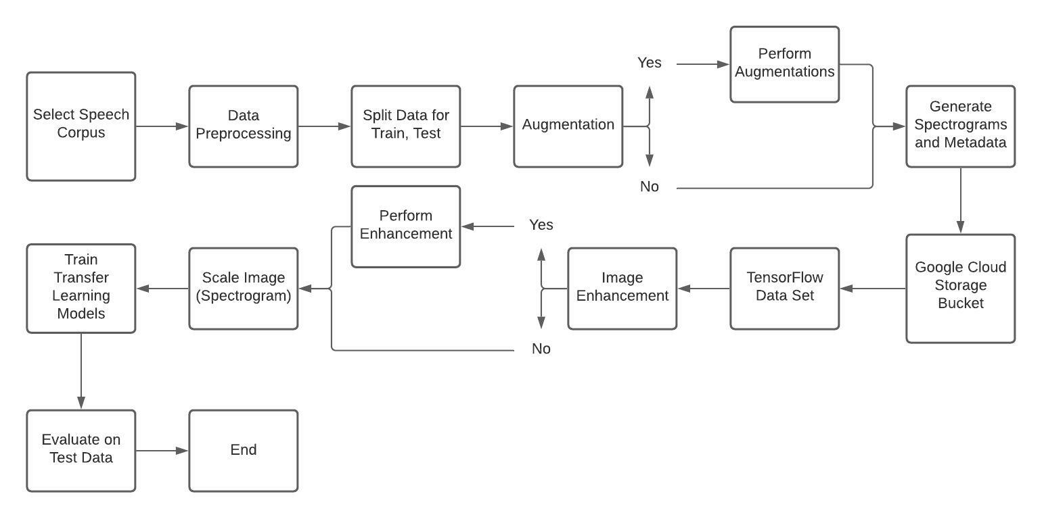
Overview of Process

Slide 37
Training and Test Set Sizes
Dataset | Training Set Size | Test Set Size
Original RAVDESS | 1,152 Samples | 288 Samples
Augmented RAVDESS | 9,216 Samples
Original CREMA-D | 5,953 Samples | 1,489 Samples
Augmented CREMA-D | 47,624 Samples

Slide 38
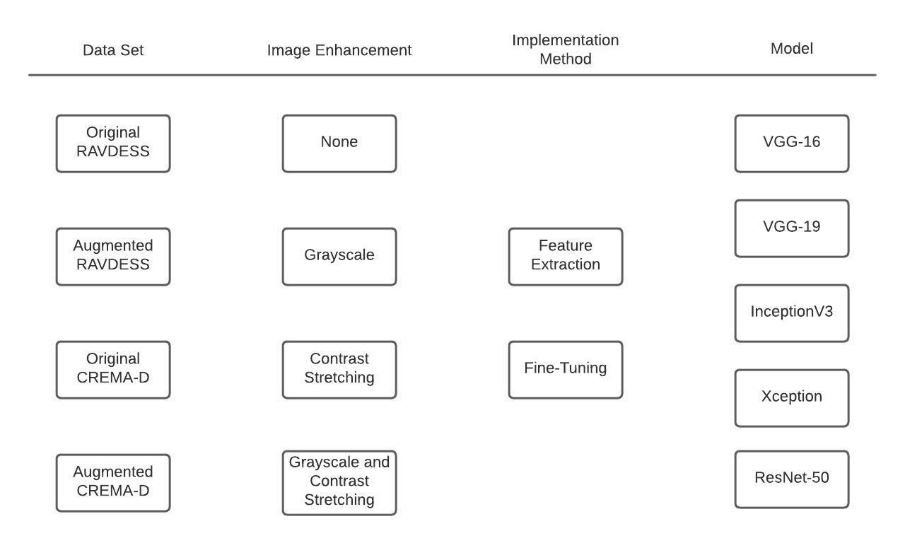
Overview of Experiments
180 experiments total
160 with transfer learning models
16 with AlexNet baseline DNN
4 with ensemble classifiers
Transfer Learning Experiments

Slide 39
Results

Slide 40
Results - RAVDESS Experiments
FE models trained on augmented training set yielded similar results to FT models trained on unaugmented training set
Models generally performed best at classifying samples of the surprise emotional class
Lowest performance when classifying samples of the sad emotional class
Model averaging ensemble of FE models yields 80% test accuracy
76% test accuracy for best individual model in ensemble
Model | Image Enhancement | Test Accuracy - Unaugmented Training Data | Test Accuracy - Augmented Training Data
VGG-16 FT | N/A | 76% | 84%
VGG-19 FT | N/A | 75% | 81%
InceptionV3 FT | N/A | 62% | 69%
Xception FT | N/A | 60% | 72%
ResNet-50 FT | GS/CS | 42% | 52%
AlexNet | N/A | 70% | 83%
Model Averaging Ensemble Test Accuracy - 85%
Best Results of Each Model

Slide 41
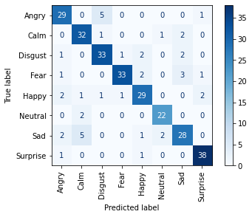
Ensemble Results - RAVDESS Experiments
Emotion | Precision | Recall | F1-Score
Angry | 81% | 83% | 82%
Calm | 80% | 89% | 84%
Disgust | 82% | 85% | 84%
Fear | 94% | 82% | 88%
Happy | 83% | 81% | 82%
Neutral | 88% | 92% | 90%
Sad | 80% | 74% | 77%
Surprise | 90% | 95% | 93%
Ensemble Test Accuracy: 85%

Slide 42
Results - CREMA-D Experiments
Deeper models experience large benefits from augmented training data
Difference in performance between FE and FT models not as large as RAVDESS experiments
Image enhancement techniques exhibit very similar performance
Within 2% - 5% typically
Models generally performed best at classifying samples of the angry emotional class
Lowest performance when classifying samples of the fear and sad emotional classes
Model | Image Enhancement | Test Accuracy - Unaugmented Training Data | Test Accuracy - Augmented Training Data
VGG-16 FT | N/A | 64% | 64%
VGG-19 FT | N/A | 63% | 63%
InceptionV3 FT | N/A | 17% | 54%
Xception FT | N/A | 17% | 57%
ResNet-50 FT | CS | 43% | 51%
AlexNet | N/A | 17% | 61%
Model Averaging Ensemble Test Accuracy - 66%
Best Results of Each Model

Slide 43
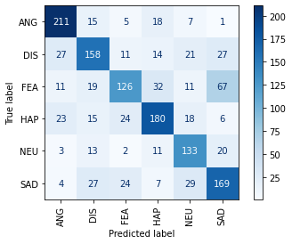
Ensemble Results - CREMA-D Experiments
Emotion | Precision | Recall | F1-Score
Angry | 76% | 82% | 79%
Disgust | 64% | 61% | 63%
Fear | 66% | 47% | 55%
Happy | 69% | 68% | 68%
Neutral | 61% | 73% | 66%
Sad | 58% | 65% | 61%
Ensemble Test Accuracy: 66%

Slide 44
General Observations
Shallower models with no image enhancement performed best on both RAVDESS and CREMA-D corpora
VGG-16 and VGG-19
Deeper models benefitted from image enhancement techniques
InceptionV3 and Xception
Fine-tuning models generally offered improved performance over feature extraction models
Particularly with the RAVDESS corpus
Models trained on augmented training datasets largely outperformed those trained on unaugmented training datasets
AlexNet models generally offered similar performance to those utilizing transfer learning and fine-tuning
Within 3% classification accuracy, typically
ResNet-50 models consistently the weakest performers

Slide 45
Comparison to State-of-the-Art Methods
RAVDESS Classification Accuracy Performance Comparison
Method | Gated ResNet CNN | 1D-CNN | Multimodal Intercorrelations | Attention-based CNN | AI-assisted Deep Stride CNN | AlexNet Model with Augmented Training Data | VGG-16 FT Model with Augmented Training Data | Model Averaging Ensemble
Reference | [5] | [2] | [3] | [1] | [4] | N/A | N/A | N/A
Accuracy | 64.48% | 71.61% | 72% | 77.4% | 80% | 83% | 84% | 85%
CREMA-D Classification Accuracy Performance Comparison
Method | Unimodal RBF-SVM with Metric Learning | AlexNet Model with Augmented Training Data and Contrast-stretching | VGG-19 FT Models with Original and Augmented Training Data | Multimodal RBF-SVM with Metric Learning | VGG-16 FT Models with Original and Augmented Training Data | Model Averaging Ensemble | Multimodal Temporal Deep Network
Reference | [7] | N/A | N/A | [7] | N/A | N/A | [6]
Accuracy | 58.2% | 62% | 63% | 63.6% | 64% | 66% | 74%

Slide 46
Conclusion

Slide 47
Contributions
Proposed methodology successfully improves performance over current SOTA unimodal methods on RAVDESS speech corpus
Yields comparable performance to both unimodal and multimodal SOTA methods on CREMA-D speech corpus
Shown that ensemble learning is a viable method for use in Speech Emotion Recognition
Reduces the dispersion of the predictions and model performance
Improved robustness
May be more suitable for real-world deployment
All trained models are saved and available for further use in research or deployment
Use as-is
Utilize as a transfer learning model
Image enhancement shown to offer marginal performance gains with deeper models
May be applicable in other domains of image classification tasks

Slide 48
Future Work

Slide 49
Aspirations
Further investigation of ensemble learning methods
Weighted model averaging ensemble
Stacked generalization ensemble
Combine RAVDESS and CREMA-D speech corpora
Oversampling
Undersampling
Real-time SER system

Slide 50
Discussion

Slide 51
References
[1] M. Xu, F. Zhang, and W. Zhang, “Head fusion: Improving the accuracy and robustness of speech emotion recognition on the IEMOCAP and Ravdess Dataset,” IEEE Access, vol. 9, pp. 74539–74549, 2021.
[2] D. Issa, M.F. Demirci, and A.Yazici,‘‘Speech Emotion Recognition With deep convolutional neural networks,’’ Biomed. Signal Process. Control, vol. 59, May 2020, Art. no. 101894.
[3] H. Li, W. Ding, Z. Wu, and Z. Liu, ‘‘Learning fine-grained multimodal alignment for speech emotion recognition,’’ 2020, arXiv:2010.12733. [Online]. Available: http://arxiv.org/abs/2010.12733
[4] Mustaqeem and S. Kwon, “A CNN-assisted enhanced audio signal processing for speech emotion recognition,” Sensors, vol. 20, no. 1, p. 183, 2019.
[5] Y. Zeng, H. Mao, D. Peng, and Z. Yi, “Spectrogram based multi-task audio classification,” Multimedia Tools and Applications, vol. 78, no. 3, pp. 3705–3722, 2019.
[6] E. Ghaleb, M. Popa, and S. Asteriadis, “Multimodal and temporal perception of audio-visual cues for emotion recognition,” 2019 8th International Conference on Affective Computing and Intelligent Interaction (ACII), 2019.
[7] E. Ghaleb, M. Popa, and S. Asteriadis, “Metric learning based multimodal audio-visual emotion recognition,” IEEE MultiMedia, vol. 27, no. 1, pp. 37–48, 2019.

